Slide 1
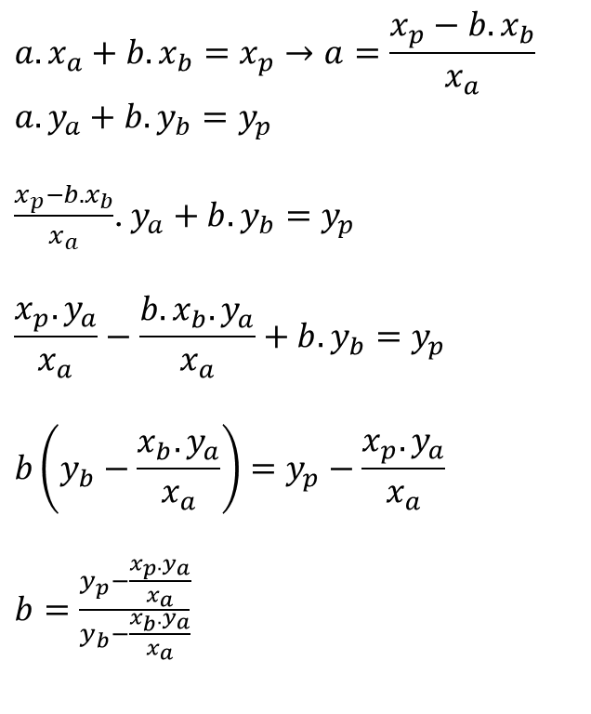
$$a.x_{a}+b.x_{b}=x_{p}→a=\frac{x_{p}−b.x_{b}}{x_{a}}$$
$$a.y_{a}+b.y_{b}=y_{p}$$
$\frac{x_{p}−b.x_{b}}{x_{a}}$. $y_{a}+b.y_{b}=y_{p}$
$$\frac{x_{p}.y_{a}}{x_{a}}−\frac{b.x_{b}.y_{a}}{x_{a}}+b.y_{b}=y_{p}$$
$$b\left(y_{b}−\frac{x_{b}.y_{a}}{x_{a}}\right)=y_{p}−\frac{x_{p}.y_{a}}{x_{a}}$$
$b=\frac{y_{p}−\frac{x_{p}.y_{a}}{x_{a}}}{y_{b}−\frac{x_{b}.y_{a}}{x_{a}}}$

